Slide 1
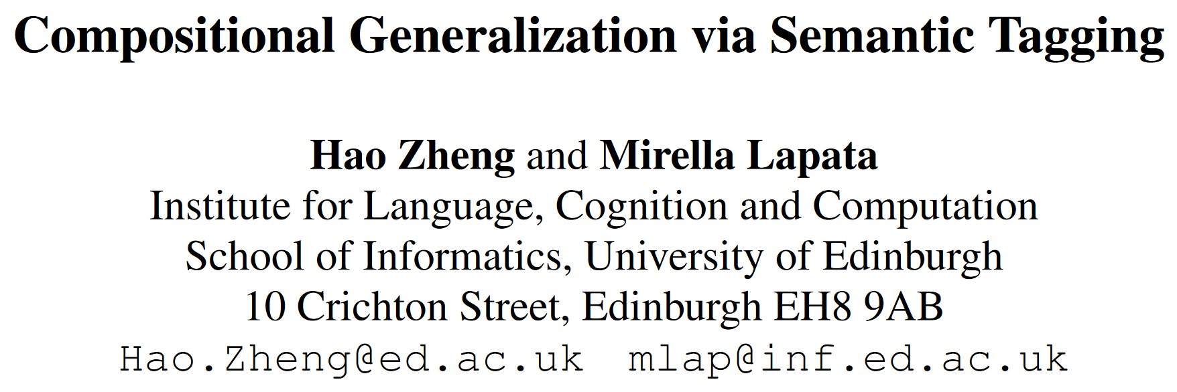
EMNLP 2021 findings (long)

Slide 2
Motivation
Current neural models fail at compositional generalization.
Unable to systematically generalize to unseen compositions of seen components.
Insights from traditional symbolic semantic parsers:
Probability of a global form is decomposed into local factors under strong conditional independence.
Explicit alignments between logical constructs and linguistic expressions.
A new decoding framework that features lexicon-style alignments and disentangled information processing.

Slide 3
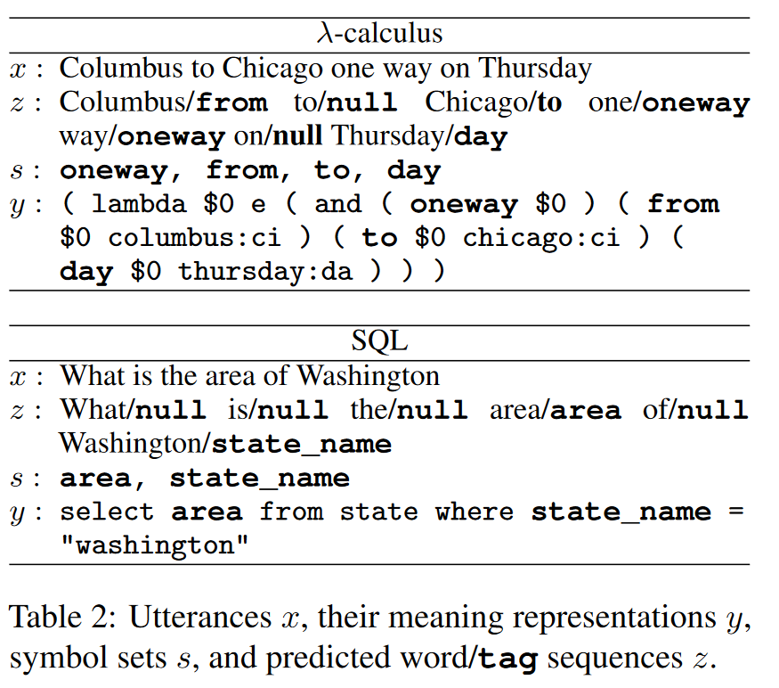
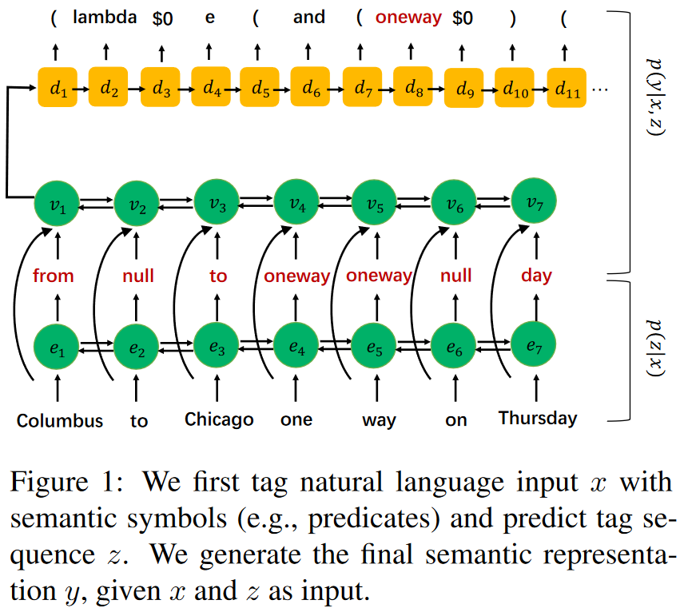
Model architecture

Slide 4
Tagger learning
Tags come from symbol (atomic semantic units) in the target.
Predicates for λ-calculus.
Column names for SQL.
Entity Linking
For λ-calculus, link predicate and its argument if it only takes one entity as argument and that can be found in the utterance.
(day $0 thursday:da) day ↔ Thursday
For SQL, if the entity in a filter clause can be linked to an expression in the utterance, link the column to the linguistic expression.
state_name = "washington" state_name ↔ Washington

Slide 5
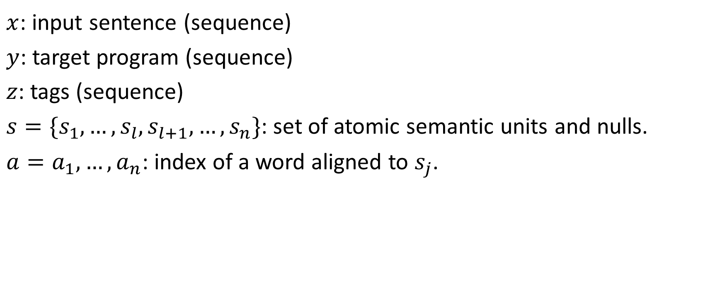
Symbol notes
$x$: input sentence (sequence)
$y$: target program (sequence)
$z$: tags (sequence)
$s=\{s_{1}, …,s_{l}, s_{l+1},…,s_{n}\}$: set of atomic semantic units and nulls.
$a=a_{1},…,a_{n}$: index of a word aligned to $s_{j}$.

Slide 6
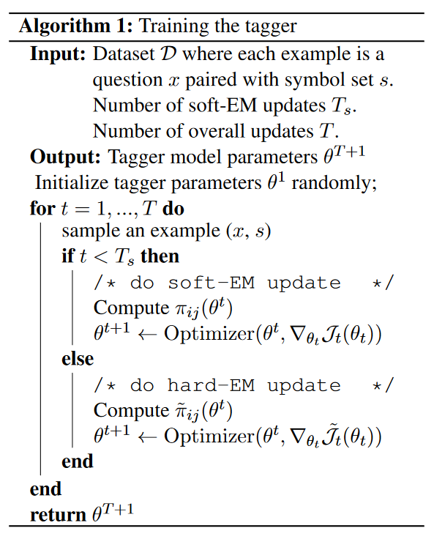
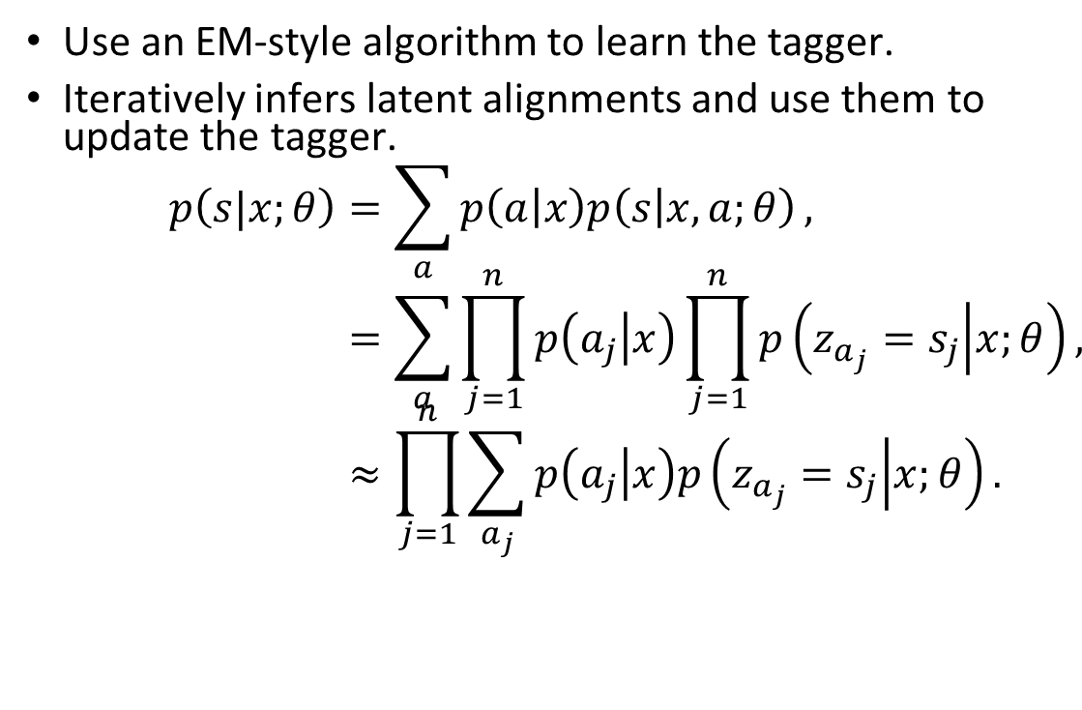
Tagger learning - Expectation Maximization
Use an EM-style algorithm to learn the tagger.
Iteratively infers latent alignments and use them to update the tagger.
$$p\left(s|x;θ\right)=\sum_{a}{p\left(a | x\right)p\left(s | x,a;θ\right)}, \\ =\sum_{a}{\prod_{j=1}^{n}{p\left(a_{j} | x\right)}\prod_{j=1}^{n}{p\left(z_{a_{j}}=s_{j} | x;θ\right)}}, \\ ≈\prod_{j=1}^{n}{\sum_{a_{j}}{p\left(a_{j} | x\right)p\left(z_{a_{j}}=s_{j} | x;θ\right)}}.$$

Slide 7
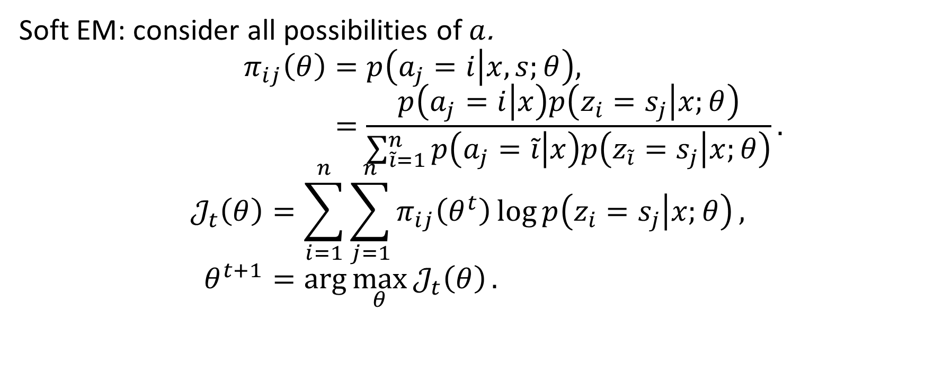
Tagger learning - Expectation Maximization
Soft EM: consider all possibilities of $a$.
$$π_{ij}\left(θ\right)=p\left(a_{j}=i | x,s;θ\right), \\ =\frac{p\left(a_{j}=i | x\right)p\left(z_{i}=s_{j} | x;θ\right)}{\sum_{\tilde{i}=1}^{n}{p\left(a_{j}=\tilde{i} | x\right)p\left(z_{\tilde{i}}=s_{j} | x;θ\right)}}.$$
$$𝒥_{t}\left(θ\right)=\sum_{i=1}^{n}{\sum_{j=1}^{n}{π_{ij}\left(θ^{t}\right)\log{p\left(z_{i}=s_{j} | x;θ\right)}}}, \\ θ^{t+1}=\arg{\max_{θ}{𝒥_{t}\left(θ\right)}}.$$

Slide 8
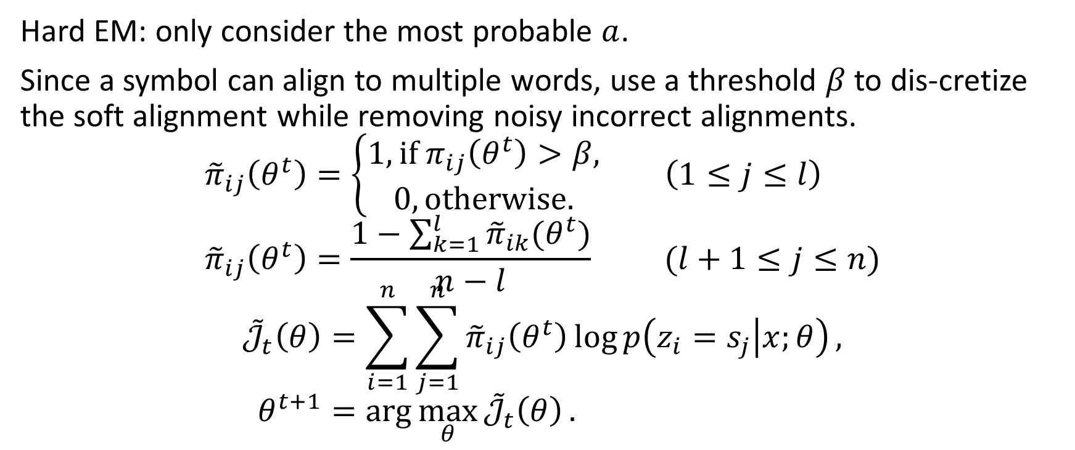
Tagger learning - Expectation Maximization
Hard EM: only consider the most probable $a$.
Since a symbol can align to multiple words, use a threshold $β$ to dis-cretize the soft alignment while removing noisy incorrect alignments.
$${\tilde{π}}_{ij}\left(θ^{t}\right)=\left\{\begin{aligned}1, if π_{ij}\left(θ^{t}\right)>β, \\ 0, otherwise.\end{aligned}\right. \left(1≤j≤l\right) \\ {\tilde{π}}_{ij}\left(θ^{t}\right)=\frac{1−\sum_{k=1}^{l}{{\tilde{π}}_{ik}(θ^{t})}}{n−l} (l+1≤j≤n)$$
$${\tilde{𝒥}}_{t}\left(θ\right)=\sum_{i=1}^{n}{\sum_{j=1}^{n}{{\tilde{π}}_{ij}\left(θ^{t}\right)\log{p\left(z_{i}=s_{j} | x;θ\right)}}}, \\ θ^{t+1}=\arg{\max_{θ}{{\tilde{𝒥}}_{t}\left(θ\right)}}.$$

Slide 9
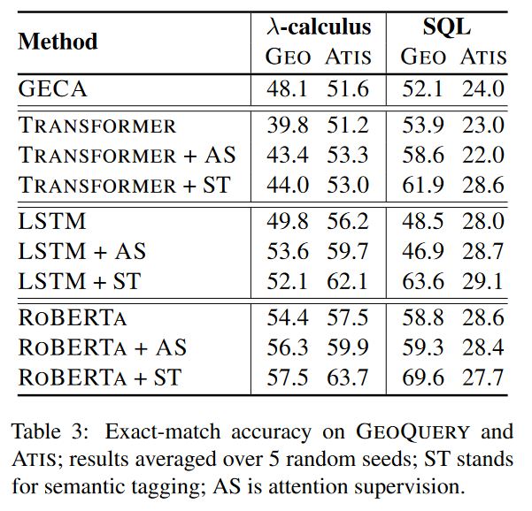
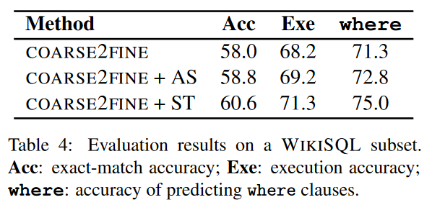
Experiments
Evaluated on query-based split of Atis, Geo and WikiSQL.
Use a subset of WikiSQL with more than one filtering condition.

Slide 10
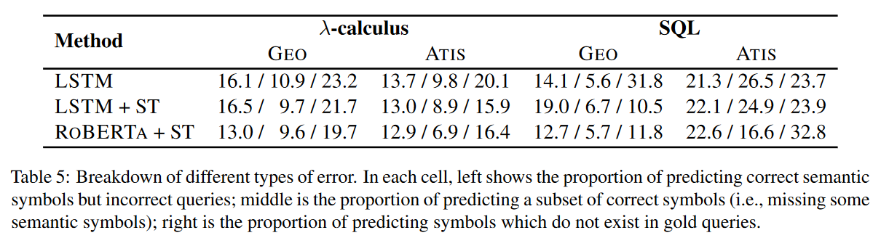
Discussion

Slide 11
Conclusion
A neural tagger that labels the input with semantic symbols representing the meaning of individual words.
Maybe useful in some DSL generation like JuICE.

